Slide 1
Gopavarapu Vamsi
Final Project
3/21/2024 Annual Review

Slide 2
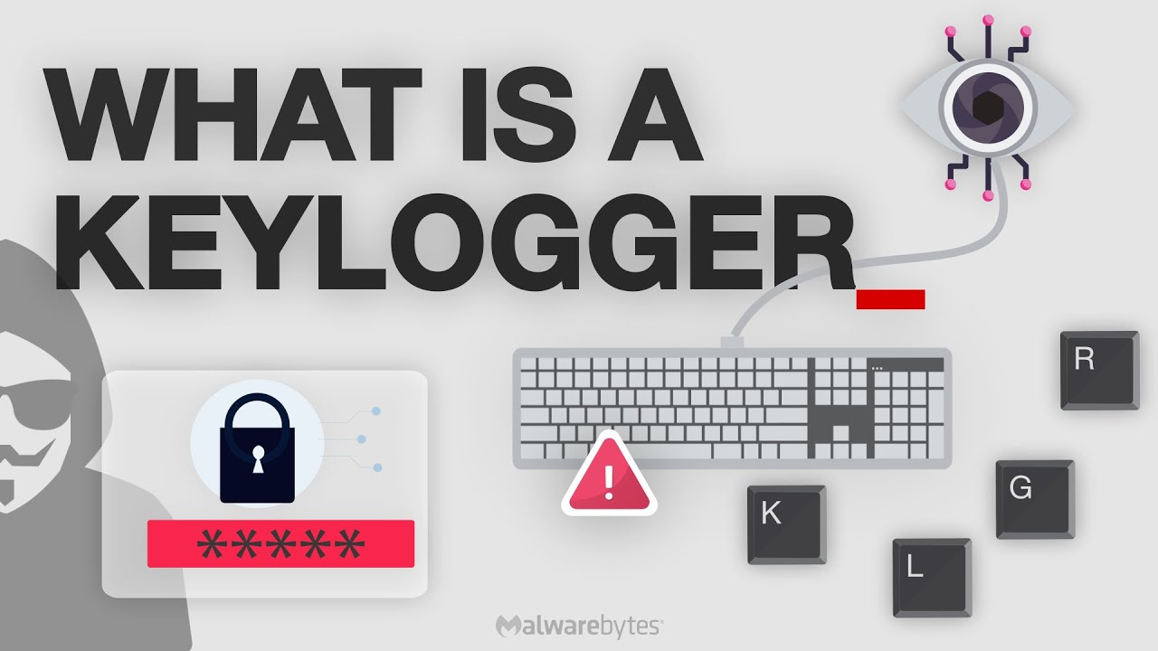
KEYLOGGER & Security
3/21/2024 Annual Review

Slide 3
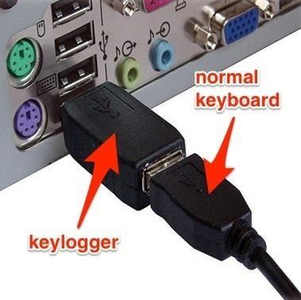
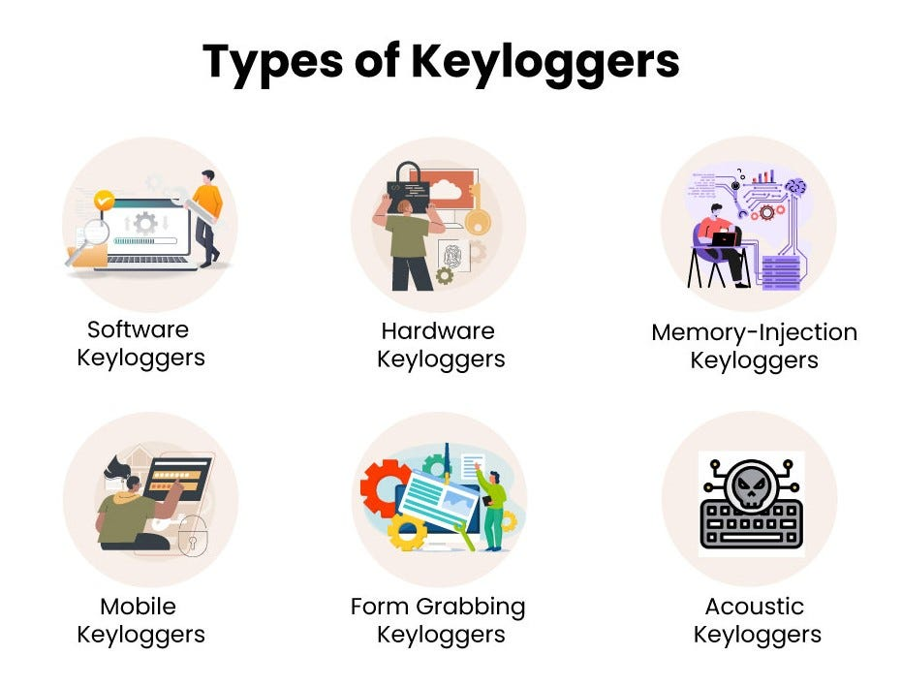

AGENDA
To know about the keylogger like what is it, how it works, its type and etc. and to secure ourselves from hacking our credentials.
A keylogger, sometimes called a keystroke logger, is a type of surveillance technology used to monitor and record each keystroke on a specific device, such as a computer or smartphone.
This keylogger can be a software or a hardware.
3/21/2024 Annual Review

Slide 4

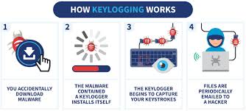
PROBLEM STATEMENT
How the keylogger program works?
What is phishing?
How do we secure ourselves from phishing?
3/21/2024 Annual Review

Slide 5

PROJECT OVERVIEW
Run the keylogger program in a python idle.
It opens a GUI screen with start and stop buttons.
When we click start, all the keystrokes that are typed from our keyboard are recorded into an external file until we click the stop button.
3/21/2024 Annual Review

Slide 6

WHO ARE THE END USERS?
The end users of this keylogger program could be individuals or organizations looking to monitor and track keyboard activity for security or monitoring purposes. However, it is essential to use such tools responsibly and ethically.
User Categories:
Parents monitoring their children's online activities .
Employers monitoring employees' computer usage.
Cybersecurity researchers studying keylogger behavior.
Individuals monitoring their own computer activity for security purposes.
User Roles:
Home users.
Business owners.
IT professionals.
Researchers
3/21/2024 Annual Review

Slide 7

YOUR SOLUTION AND ITS VALUE PROPOSITION
Product/System Name: Keylogger System.
Description:
A software-based keylogger that records and tracks keystrokes in real-time.
Key Features:
Advanced filtering and search capabilities .
User-friendly interface .
Multi-device support .
Real-time keystroke recording.
Technology/Platform:
Developed in Python, compatible with Windows, Mac, and Linux
3/21/2024 Annual Review

Slide 8

THE WOW IN YOUR SOLUTION
Breakthrough Technology: Our Keylogger System utilizes advanced algorithms and machine learning to detect and record keystrokes with unprecedented accuracy and speed.
Real-Time Insights: Get instant access to keystroke data, allowing you to respond quickly to potential security threats or monitor activity as it happens.
Advanced Analytics: Our system provides in-depth analysis and visualization of keystroke data, helping you identify trends, patterns, and anomalies.
Ease of Use: Intuitive interface and user-friendly design make it easy to deploy, configure, and use our Keylogger System, even for non-technical users.
Scalability: Our solution is designed to handle large volumes of data and scale with your needs, making it perfect for large enterprises or small businesses alike.
Customization: Tailor our Keylogger System to fit your specific needs, with customizable alerts, filters, and reports.
Unparalleled Support: Our dedicated team provides top-notch support, ensuring you get the most out of our solution.
3/21/2024 Annual Review
8

Slide 9
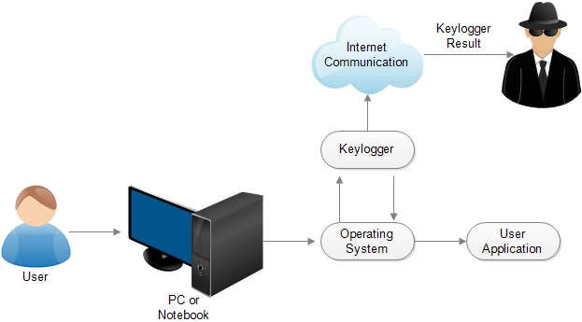
MODELLING
The keylogger program is designed to listen for keypress and release events using the pynput library. It categorizes the keys as pressed, held, or released and saves this information in both a text file ('key_log.txt') and a JSON file ('key_log.json'). The GUI built with Tkinter includes buttons to start and stop the keylogger, along with a label to display the program's status.
3/21/2024 Annual Review
9

Slide 10
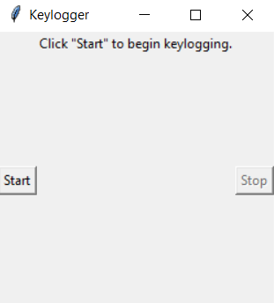
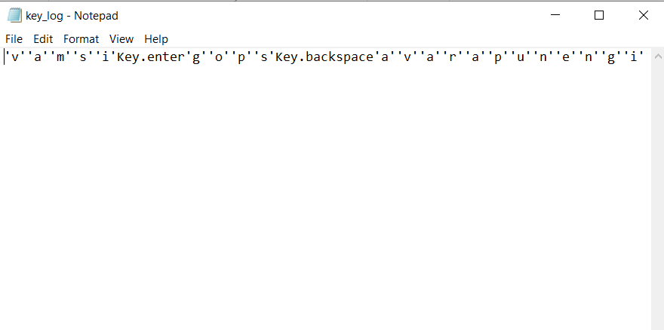
RESULTS
3/21/2024 Annual Review
10

